Slide 1
Provider Revalidation Process

Slide 2
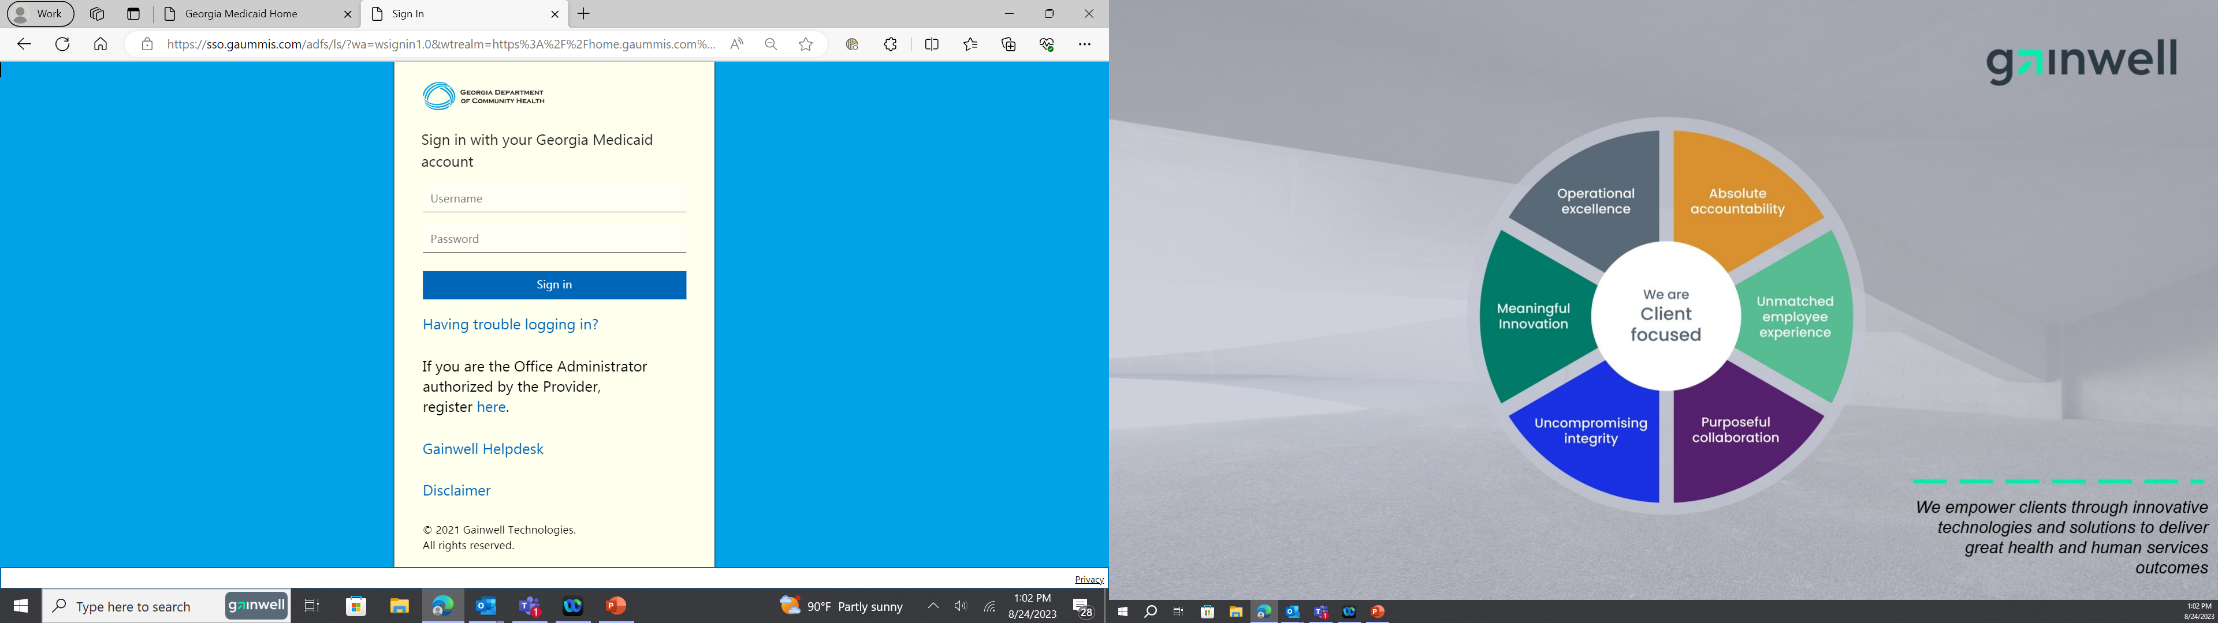
GAMMIS Login
Login into secure area of the GAMMIS Web Portal, mmis.georgia.gov
Select Web Portal

Slide 3
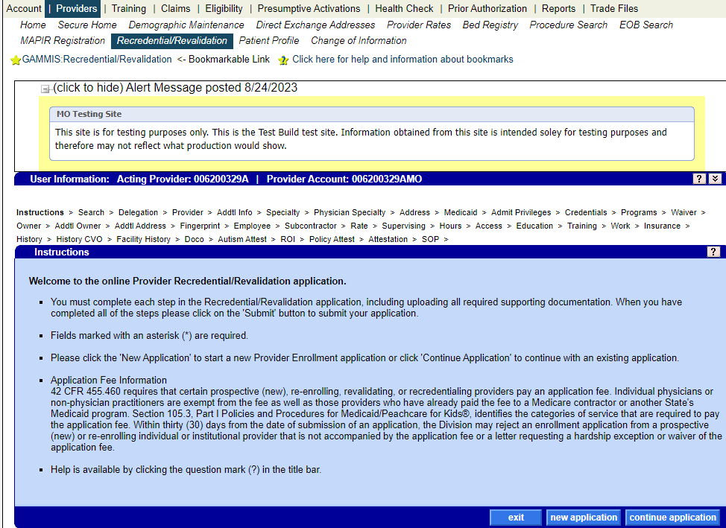
Provider Revalidation Process

Slide 4
Provider Revalidation Application
Select New Application from the bottom of page.

Slide 5
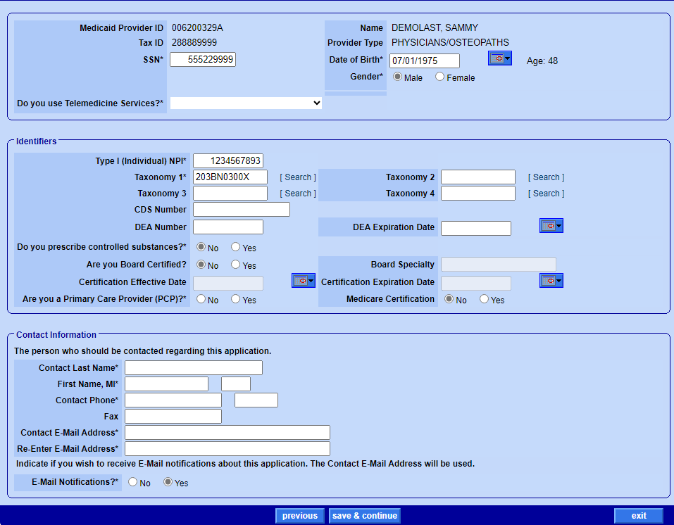
Provider Revalidation Application
(continued)
Complete all fields with an asterisk (*).
Save & Continue

Slide 6
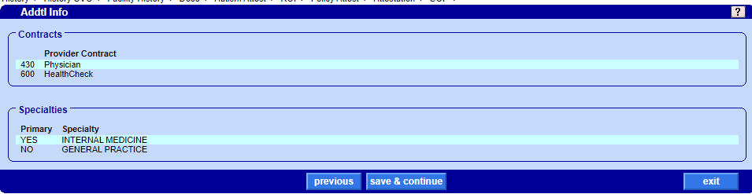
Provider Revalidation Application
(continued)
Review: Provider Contract and Specialty Information
Save & Continue

Slide 7
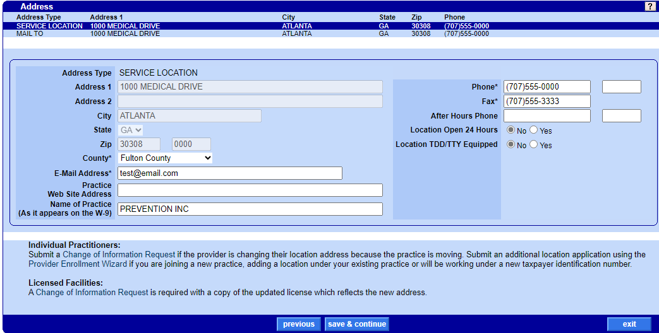
Provider Revalidation Service Location Address Panel

Slide 8
Provider Revalidation Service Location Address Panel
Update the following asterisk information:
County
Email Address
Telephone Number
Save and Continue
Note: If a provider is changing their location address because the practice is moving a Change of Information Request must be submitted.

Slide 9
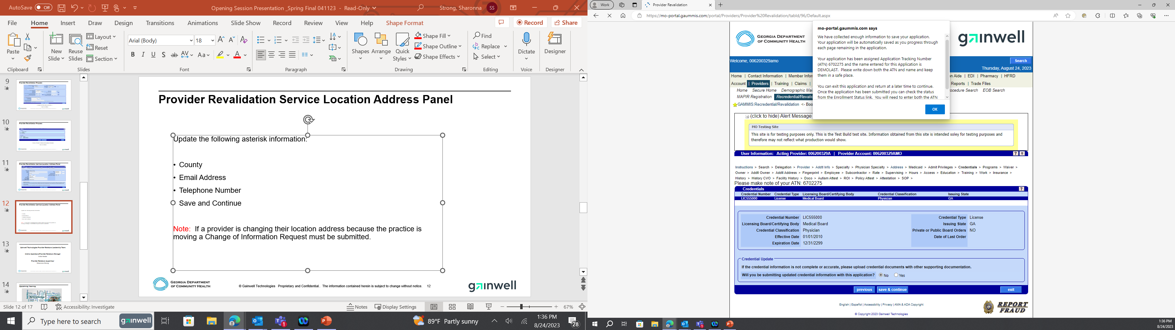
Provider Revalidation Application
(continued)
The ATN for your application request will appear in the information box at the top of the screen.
All your information has been saved. Should you need you may Exit the application and return later to complete.

Slide 10
Provider Revalidation Process
Select OK *in the information panel
Review Credentialing Information, Save & Continue

Slide 11
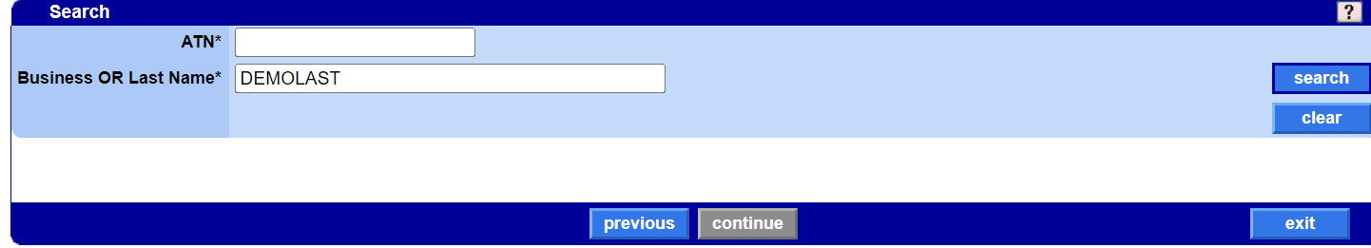
Application Search Panel
If you Exit the application you would enter your ATN number and select Search

Slide 12
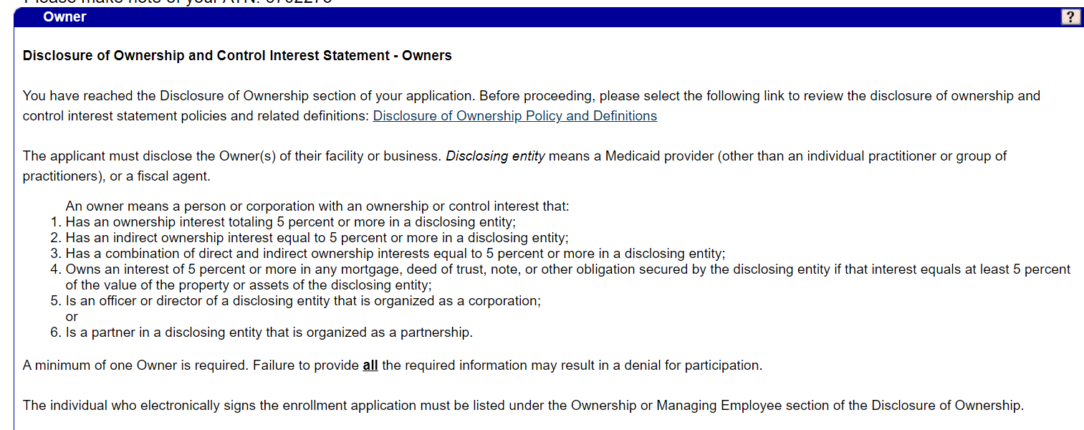
Disclosure of Ownership

Slide 13
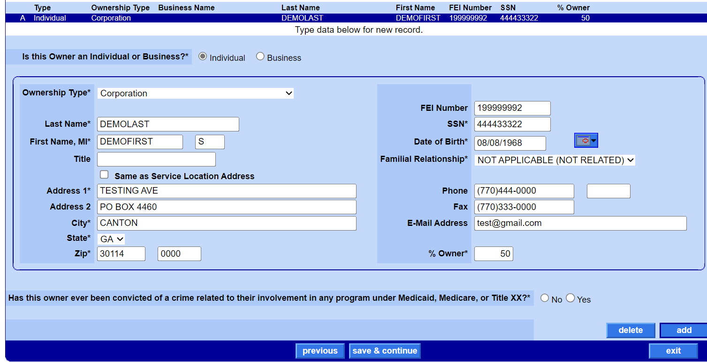
Disclosure of Ownership
Review, Confirm, and Answer all items marked with an asterisk (*).
Save & Continue

Slide 14
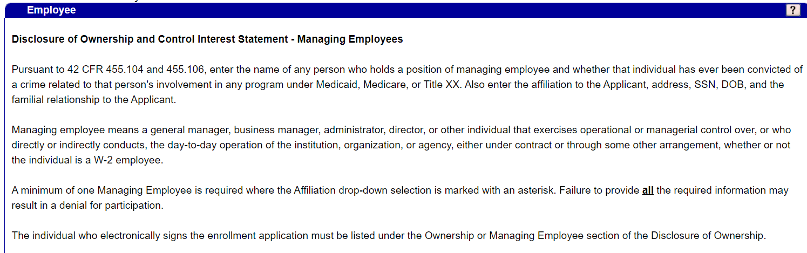
Disclosure of Ownership and Control Interest Statement –Managing Employees

Slide 15
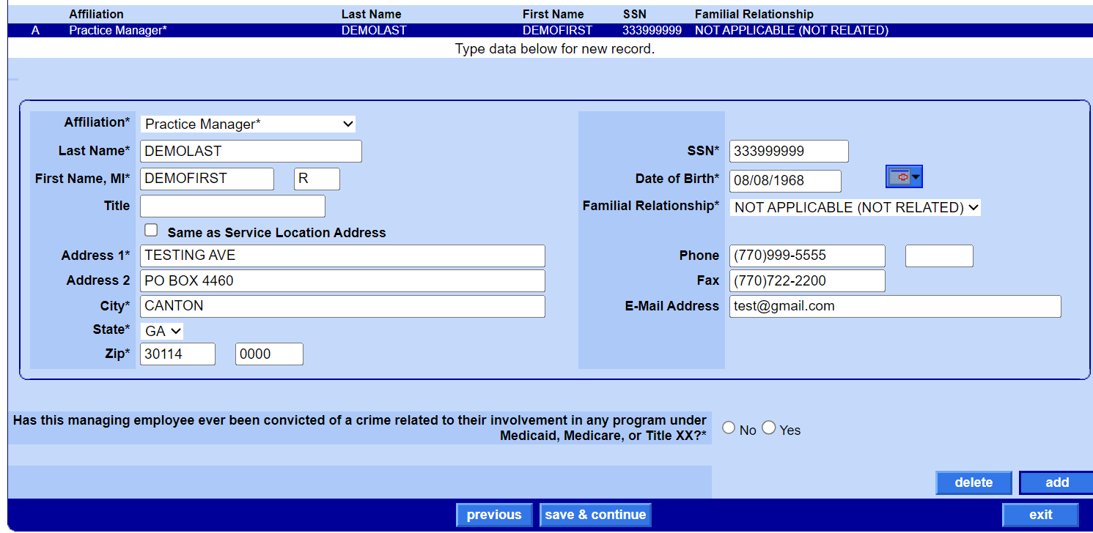
Disclosure of Ownership and Control Interest Statement –Managing Employees
Review, Confirm, and Answer all items marked with an asterisk (*).
Save & Continue

Slide 16
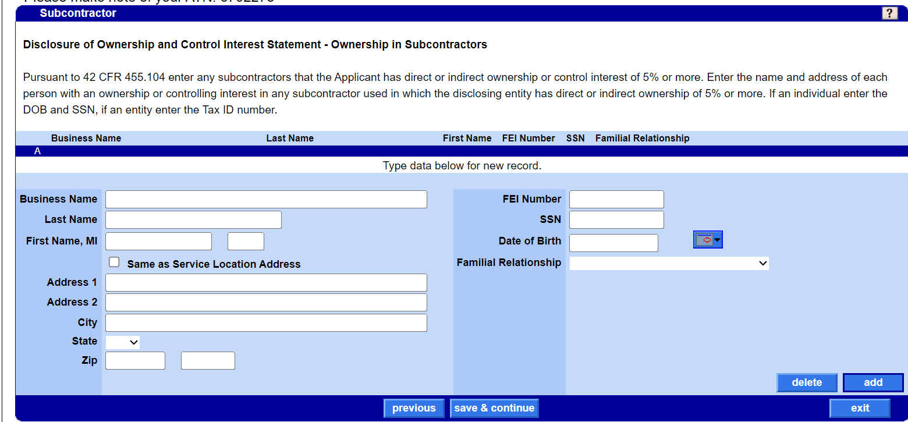
Disclosure of Ownership and Control Interest Statement – Ownership in Subcontractors
If applicable enter information for any subcontractors that the Applicant has direct or indirect ownership or control interest of 5%.
Save & Continue

Slide 17
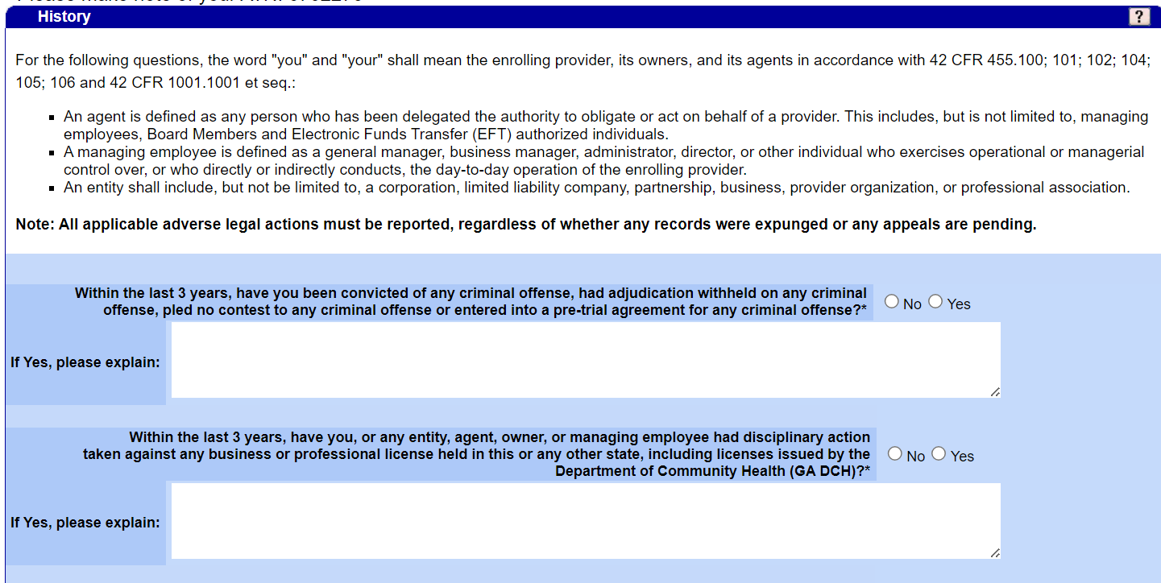
History
Answer Yes or No to all 12 questions as it pertains to the enrolling provider, its owners, and its agents.
All applicable adverse legal actions must be reported, regardless of whether any records were expunged or any appeals are pending.
Save & Continue

Slide 18
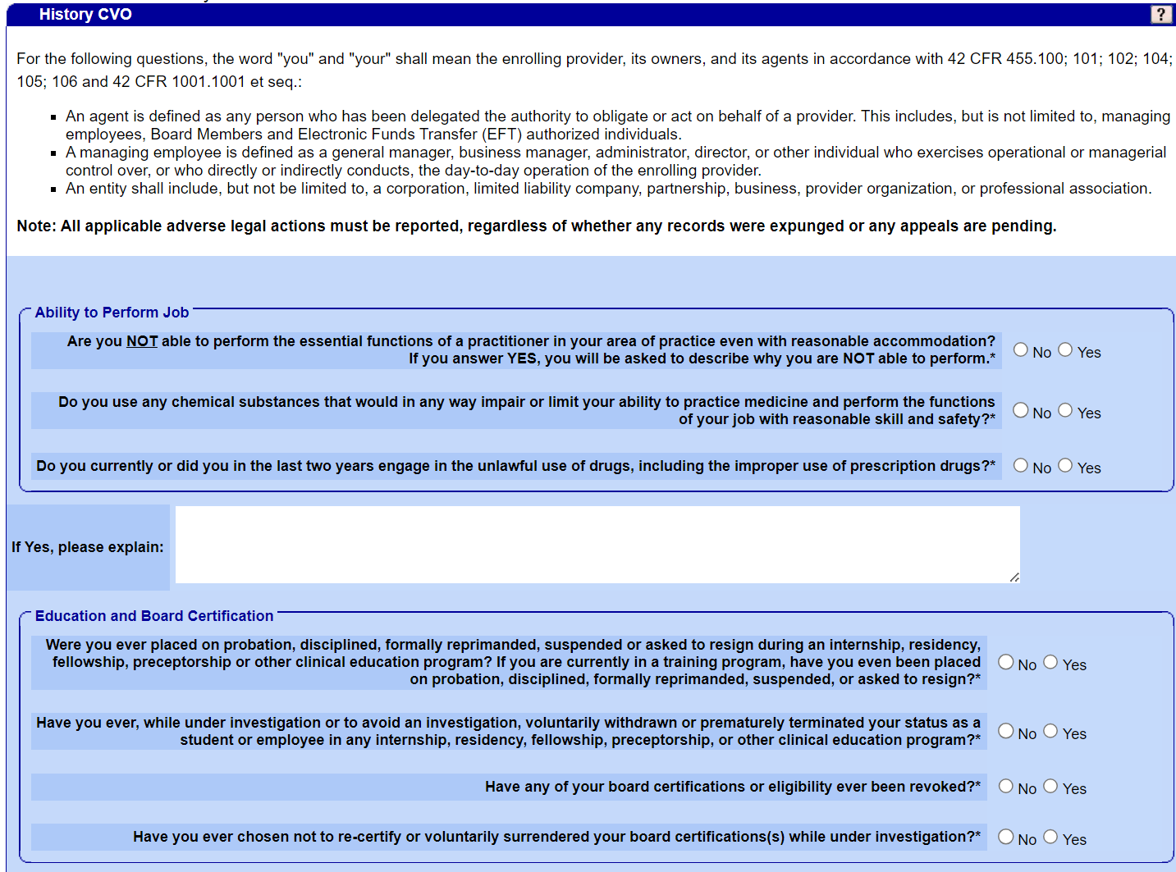
History CVO
Answer Yes or No to all 18 questions as it pertains to the enrolling provider, its owners, and its agents.
All applicable adverse legal actions must be reported, regardless of whether any records were expunged or any appeals are pending.
Save & Continue

Slide 19
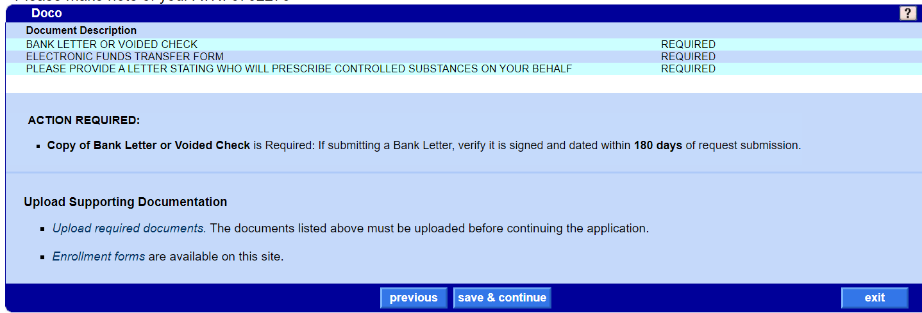
DOCO
Select Upload Required Documents

Slide 20
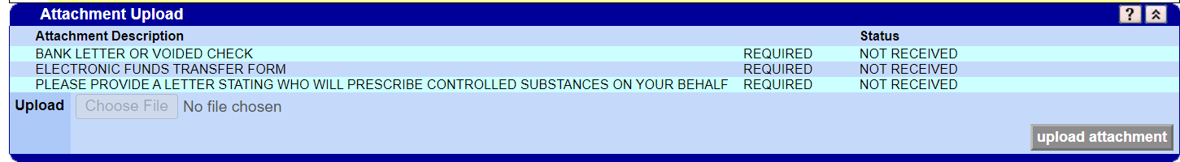
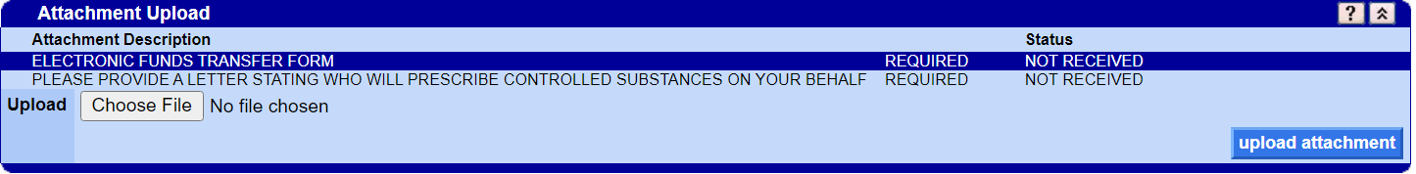
Documents Required
The upload Panel will appear in a separate screen
Highlight the line for the item you will be uploading

Slide 21
Documents Required
(continued)
Once all Documents have been uploaded close page and you will return back to the application

Slide 22
Documents Required
(continued)
Once documents have been uploaded save and continue

Slide 23
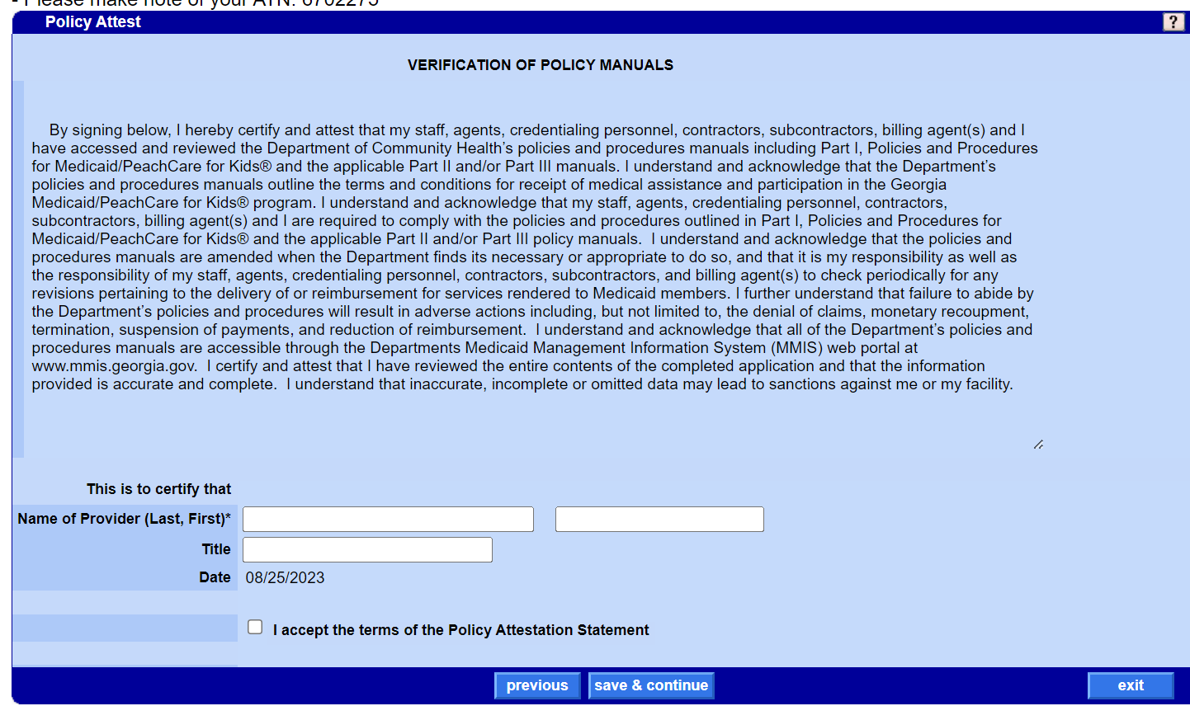
Policy Attestation
Read Verification of Policy Manuals Statement
Certify with Name of Provider
Accept the terms of the Policy Attestation Statement

Slide 24
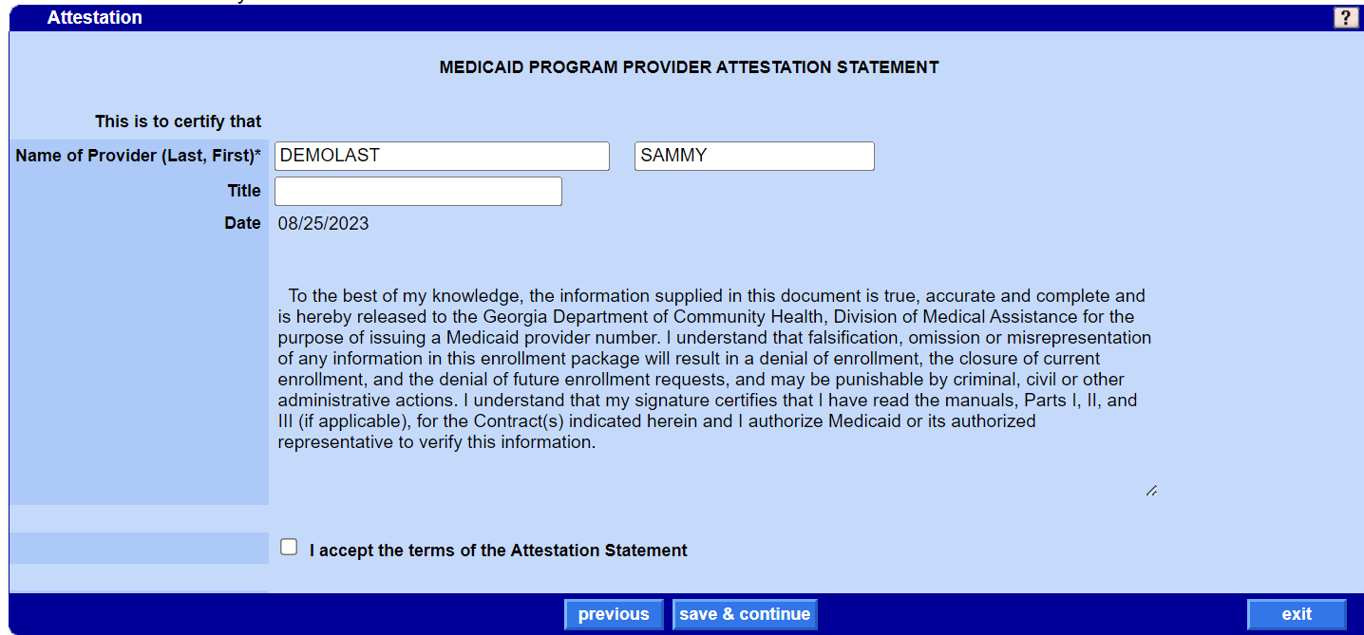
Attestation Statement
Read MEDICAID PROGRAM PROVIDER ATTESTATION STATEMENT
Accept the terms of the Attestation Statement

Slide 25
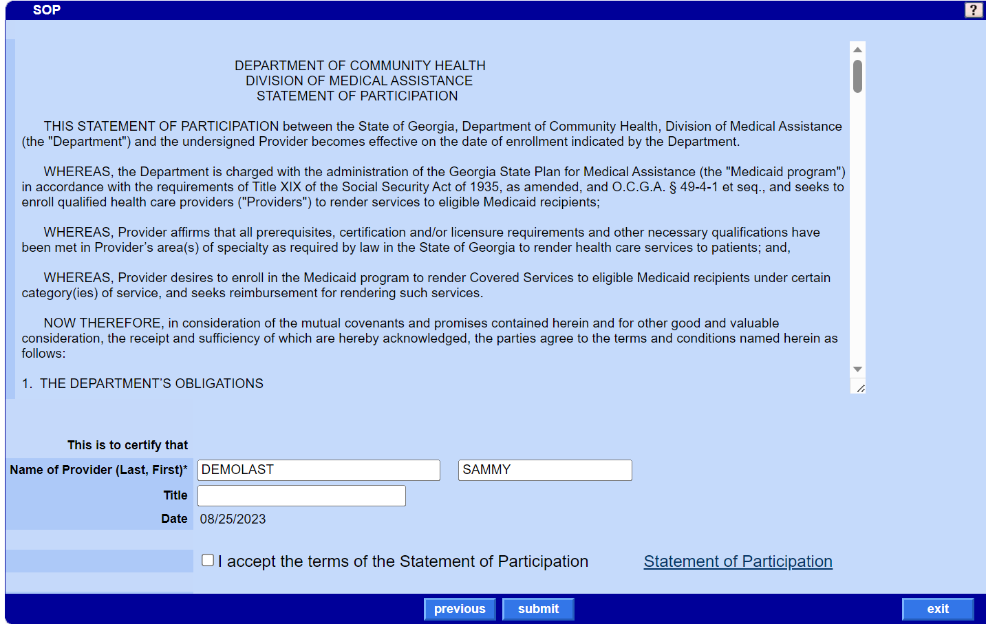
Statement of Participation
Read Statement Of Participation
Accept the terms of the Statement of Participation
SUBMIT

Slide 26
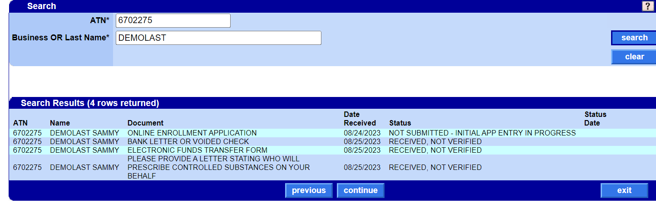
Application not Submitted
Read MEDICAID PROGRAM PROVIDER ATTESTATION STATEMENT
Accept the terms of the Attestation Statement

Slide 27
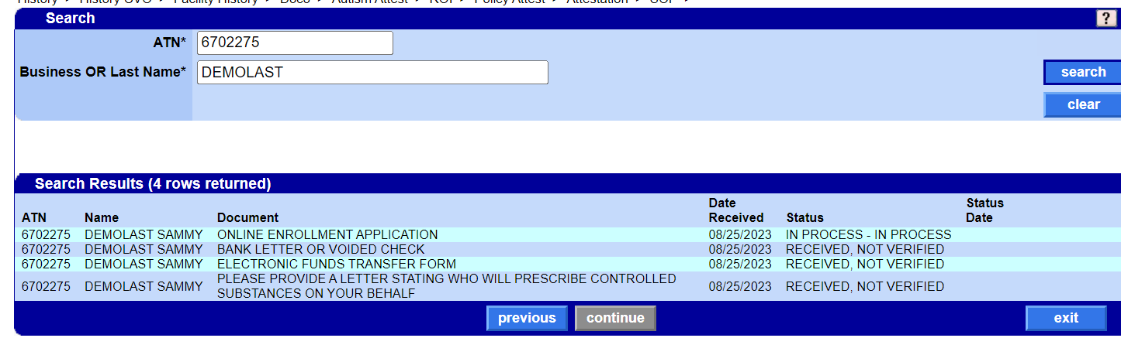
Successfully Submitted
Status: IN-PROCESS

Slide 28
Thank you!

